Slide 1
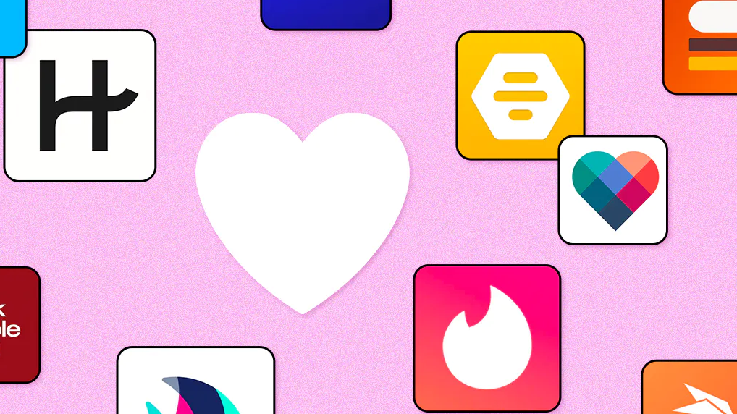
Exploratory Analysis of Dating Applications
Team Members: Ramiro Cervantes, Paola Moreno, Estela Perez

Slide 2
Background
Covid-19 pandemic affected the way people interacted with one another. Being that the pandemic forced everyone to isolate, not only by mandate, but also by fear of contracting the infection by human contact; people who were looking for courtship began accepting different ways to socialize. Many people turned to dating applications which became more commonly accepted platforms during the pandemic, where they socially connected without any fears of becoming infected.

Slide 3
Thesis
Our project will analyze the dating pool within the dating application OkCupid.
We will provide a summary of demographic data, including, gender, sexual orientation, zodiac sign and economic characteristics.
In addition, we will be comparing the ratings and “success” rates of the apps to determine their efficiency.
Lastly, we will be comparing the stock value of Match Group Inc (MTCH) and Bumble (BMBL) from 2019 – 2022.

Slide 4


What does the online dating pool look like?

Slide 5
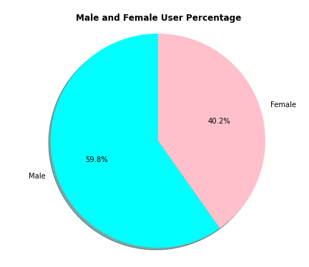
Gender
Out of OkCupid's most recent data of 59,946 total users

Slide 6
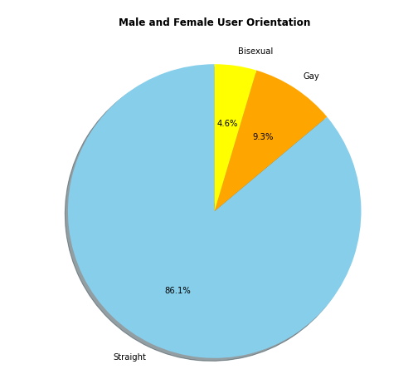
Sexual Orientation
Out of OkCupid's most recent data of 59,946 total users

Slide 7
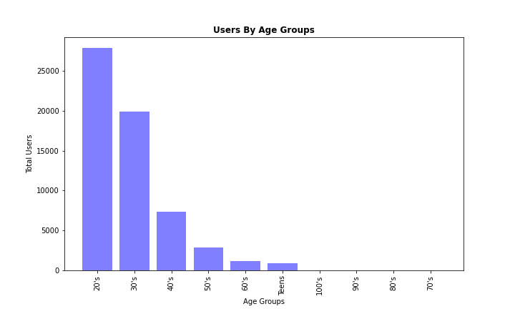
Age
Out of OkCupid's most recent data of 59,946 total users

Slide 8
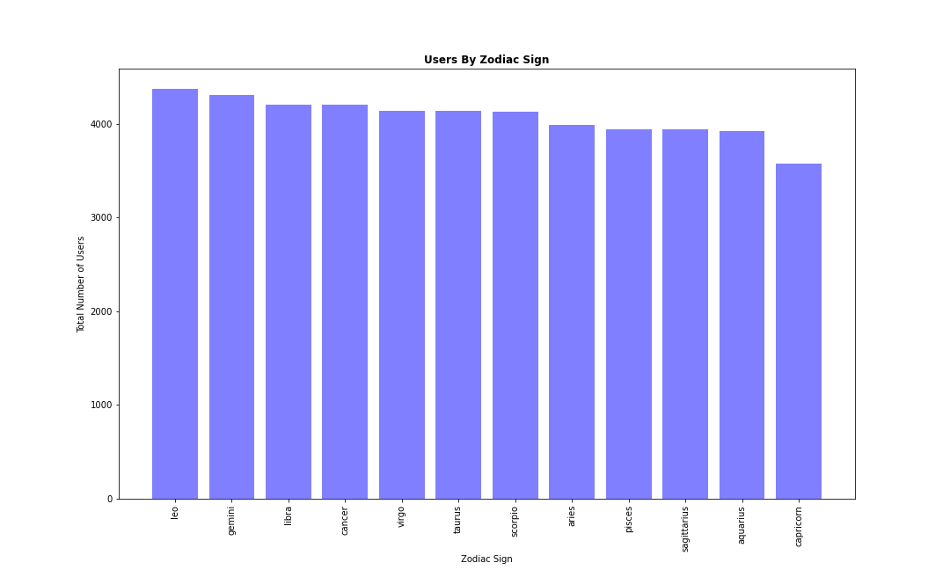
Zodiac Sign
Out of 59,946 total users only 48,890 shared their zodiac sign

Slide 9
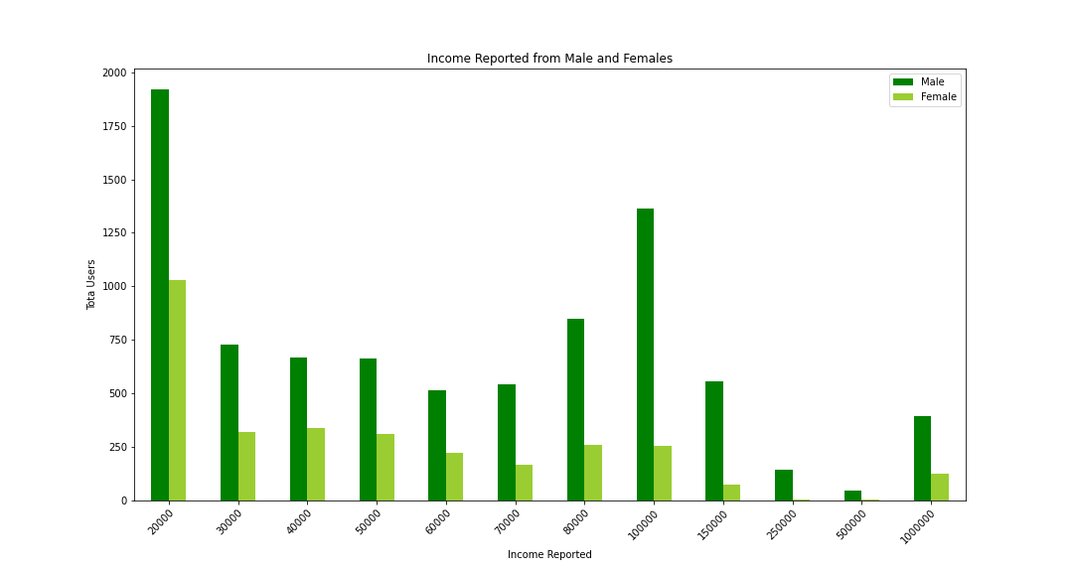
economic characteristics
Out of 35,829 male users only 8,391 responded to their income level
Out of 24,117 female users only 3,113 responded to their income level

Slide 10

When comparing OkCupid, Tinder, and Hinge, which app is the best rated?

Slide 11
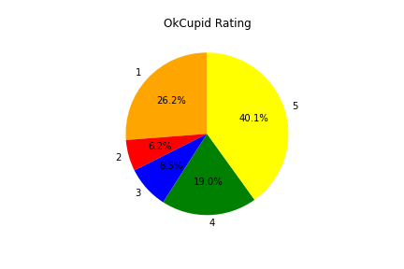
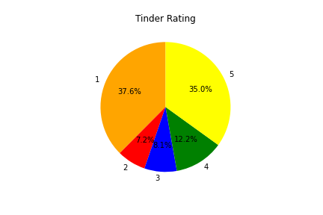
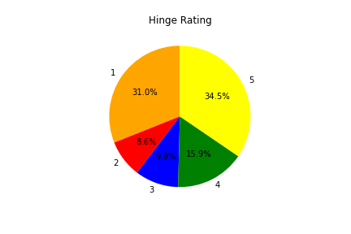
(1-5) Star ratings form the Google Play Store reviews as of May 2022

Slide 12
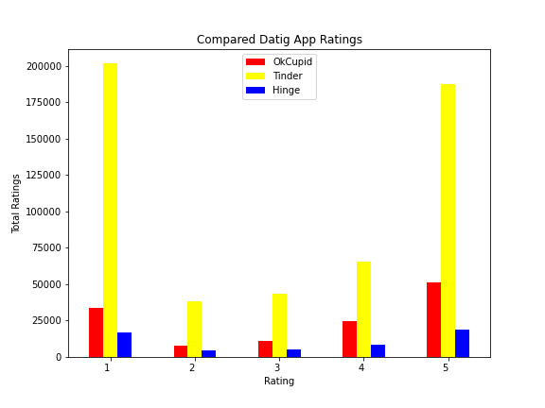
Comparison of all three total app reviews

Slide 13

How successful are these apps?

Slide 16
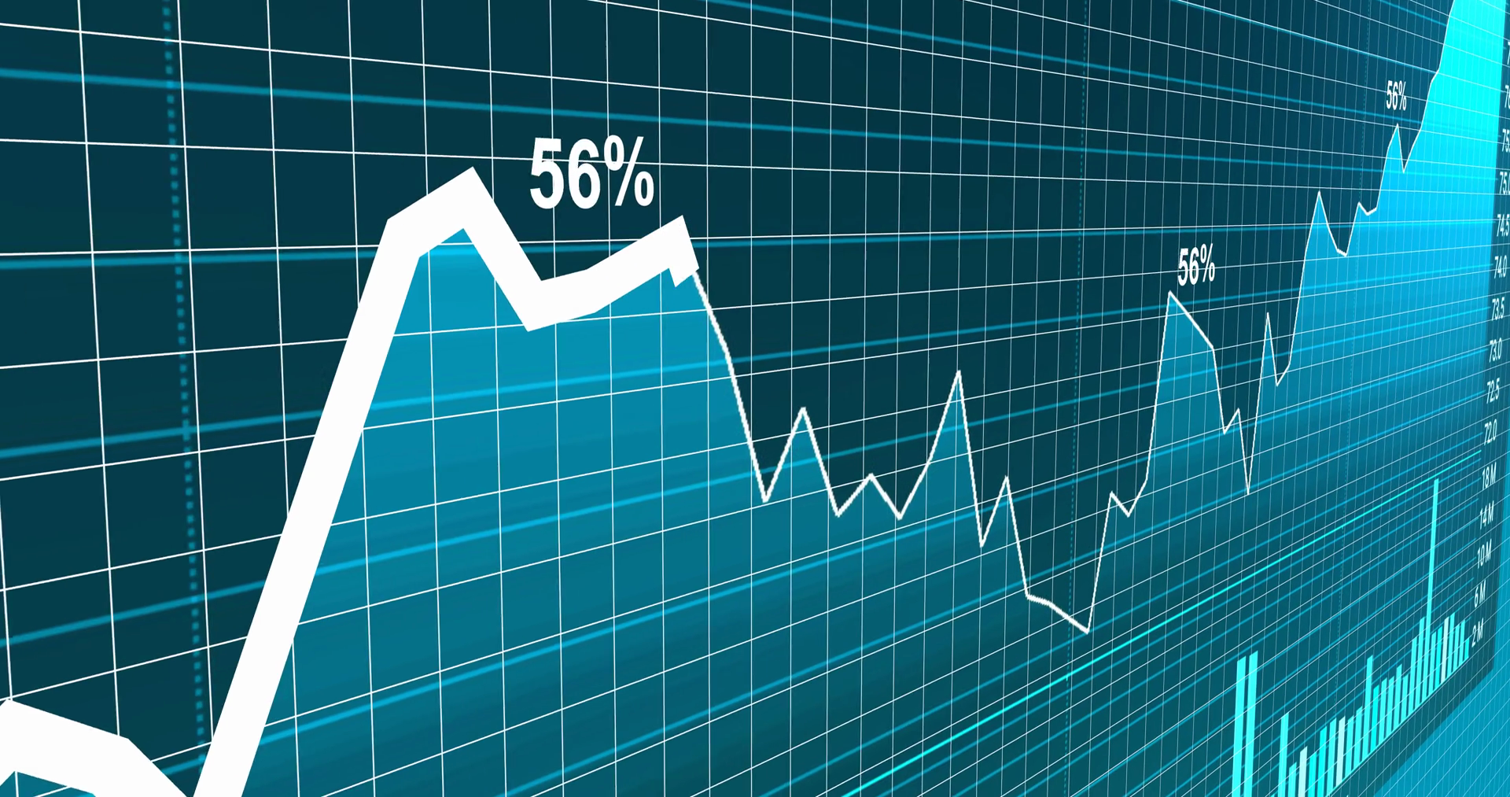
Has there been a change in the companies grows due to the pandemic?

Slide 19
Conclusion

Slide 20

Limitations and difficulties

Slide 21

Limitations and difficulties
There was no control over the type of datasets collection of data.

Slide 22
Links
Datasets
OkCupid Profiles | Kaggle
Tinder Dating App - Google Play Store Review | Kaggle
Hinge Dating App - Google Play Store Review | Kaggle
OkCupid Dating App - Google Play Store Reviews | Kaggle
Tinder Millennial Match Rate | Kaggle
API
Free Stock APIs in JSON & Excel | Alpha Vantage

Slide 23
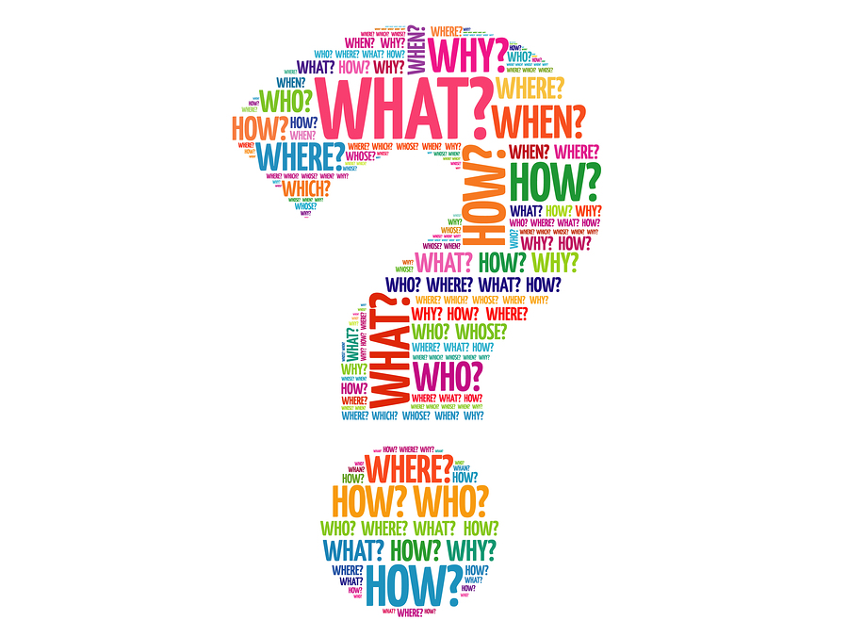
Questions and comments

